Slide 1




Carmondean ELC
Refreshed Vision, Values and Aims

Slide 2
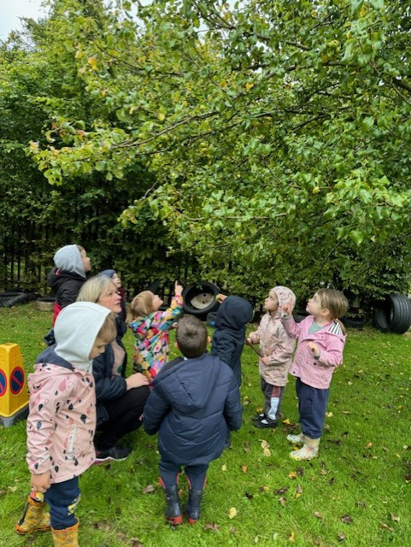
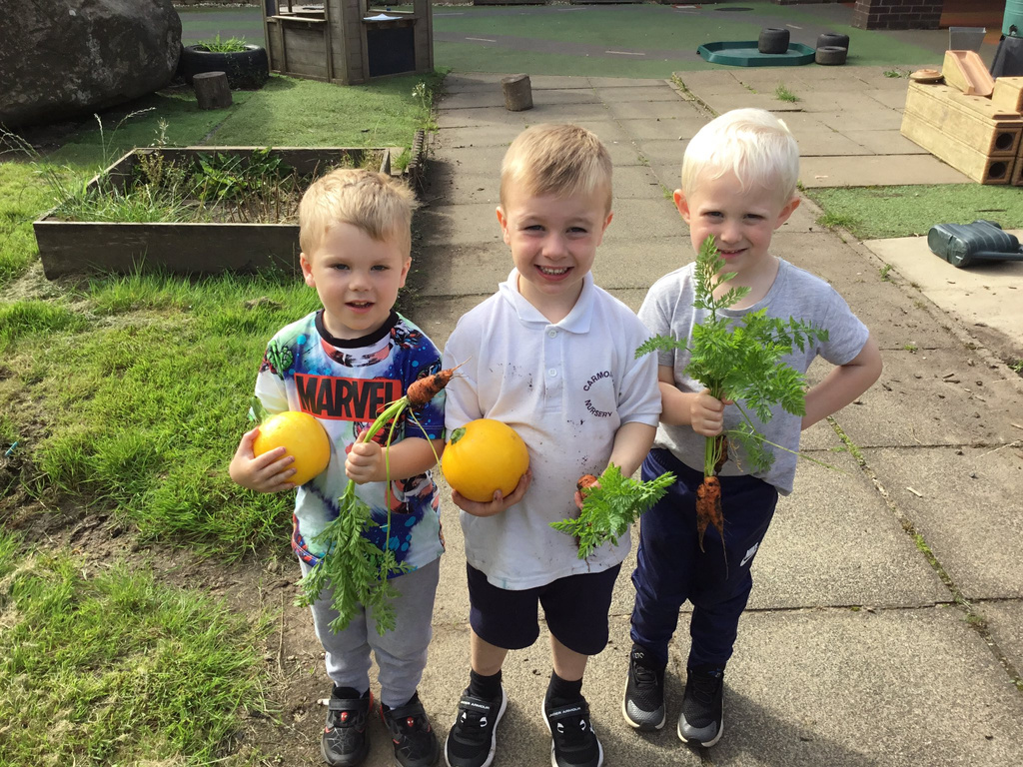
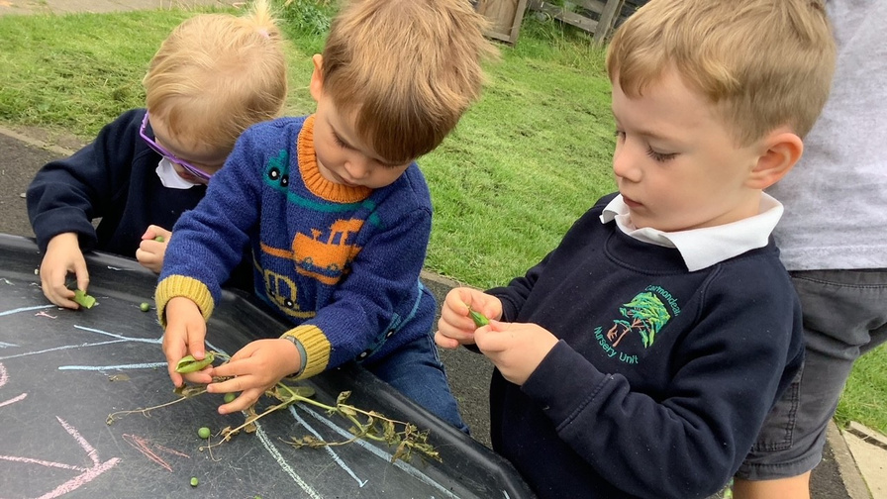
As a team, we discussed the uniqueness of our setting and discussed what anyone coming into our setting should see, hear and feel. ​

Slide 3


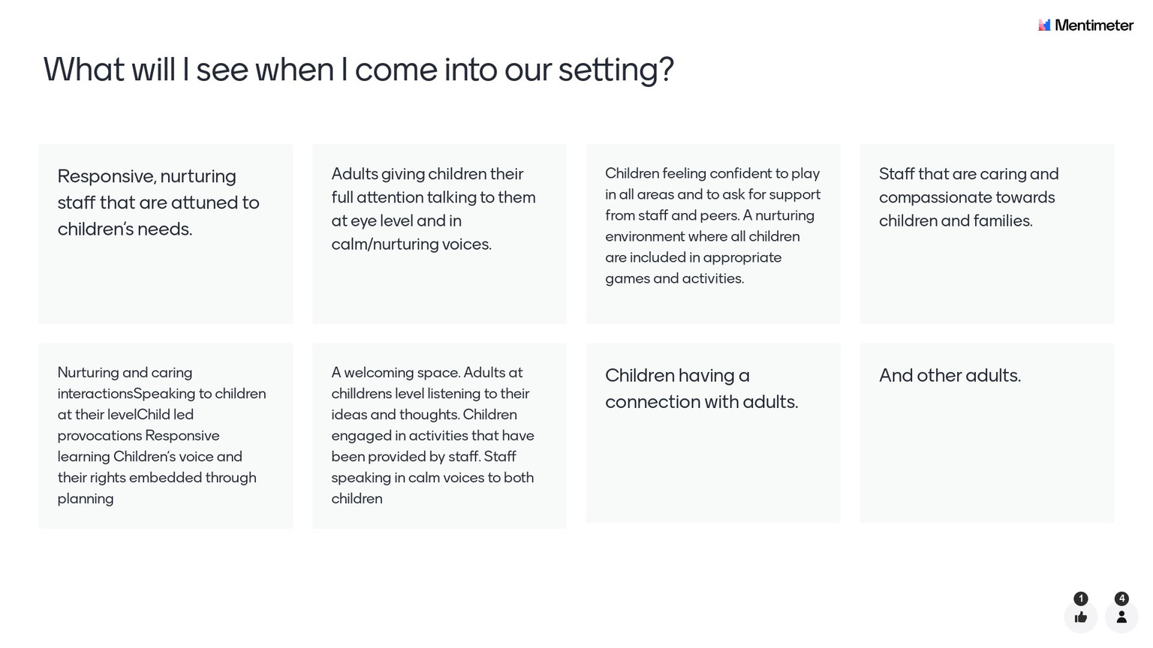


Slide 4
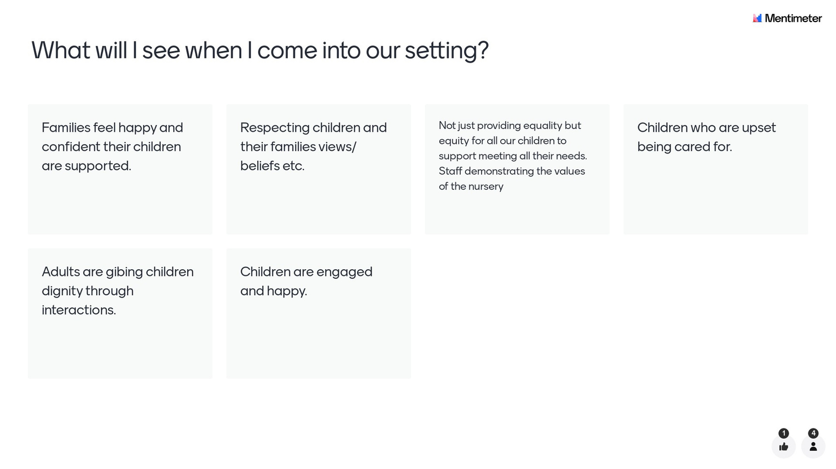

Slide 5
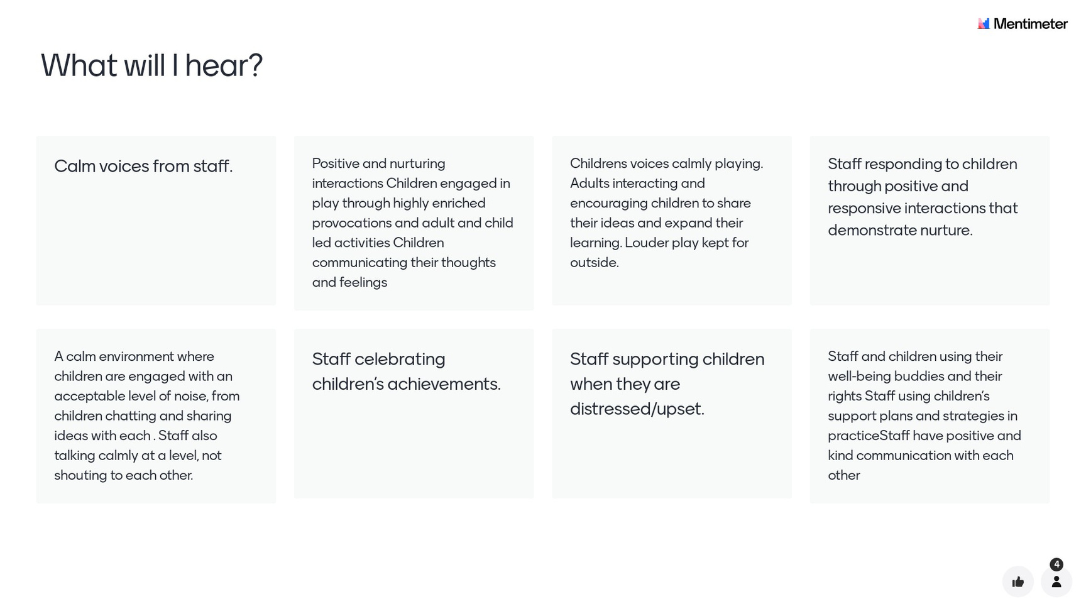

Slide 6
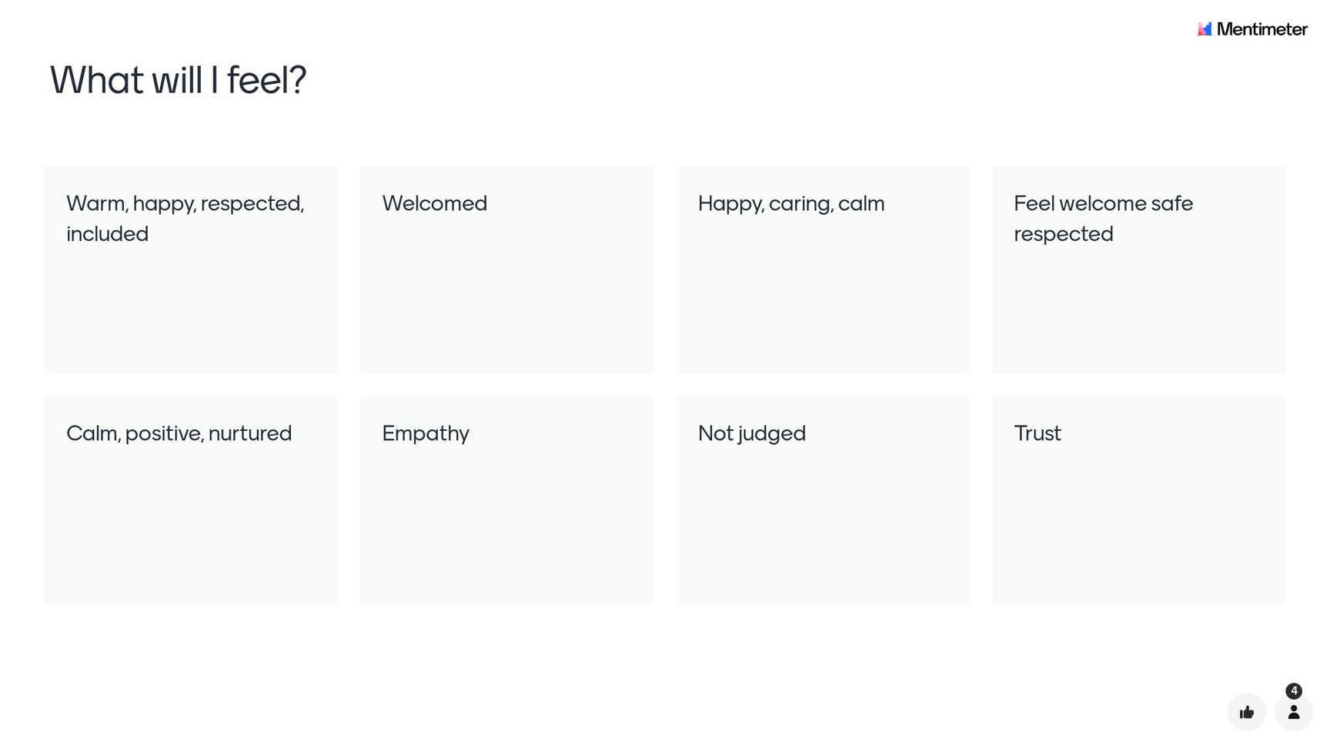

Slide 7

We also asked our Stakeholders their views...​
'Whenever I attend Carmondean ELC, I am always so happy to see all adults busy with the children, down at their level playing together. I always feel very welcome and very much part of the team.'​

Slide 8

And our families...
I want my child to build positive friendships with other children. To make the transition to P1 slightly easier for my child by getting to see familiar staff, familiar classrooms.
Help, encouragement nurtured ​
Learning to respect other kids and adults.​
Learning to be social withther children and adults in a safe and nurturing environment.
I want my child to feel confident and safe. We want him to build relationships and be school ready. We want him to still be his little self but encouraged to try new things and to be included in decisions when it comes to activities or topics. We just want him to be happy.​
I want my child to become a confident and well-mannered individual who embraces diversity. Who demonstrates great ethics and values. She should develop the urge towards better learning in the future.
To be safe and cared for, to make friendships and explore, to be treated with respect and feel involved​

Slide 9
Using this feedback, we have developed our updated vision...
'To create a nurturing ELC community where all children are included, feel safe and achieve.'​

Slide 10
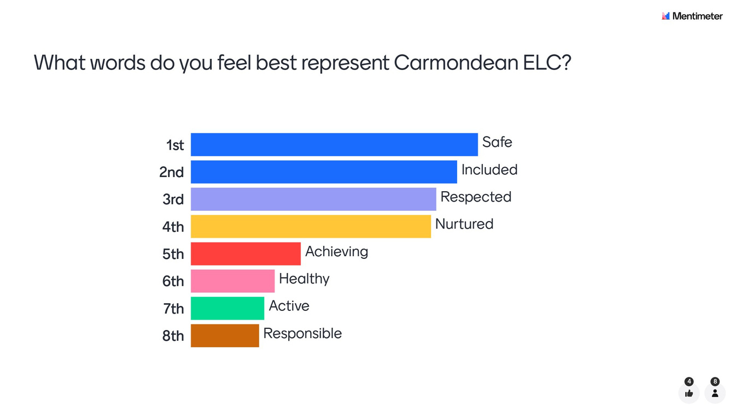
We then moved onto looking at what values will underpin our updated vision. Our staff team prioritised the Wellbeing Indicators that they felt were most important for our setting using a Mentimeter.

Slide 11
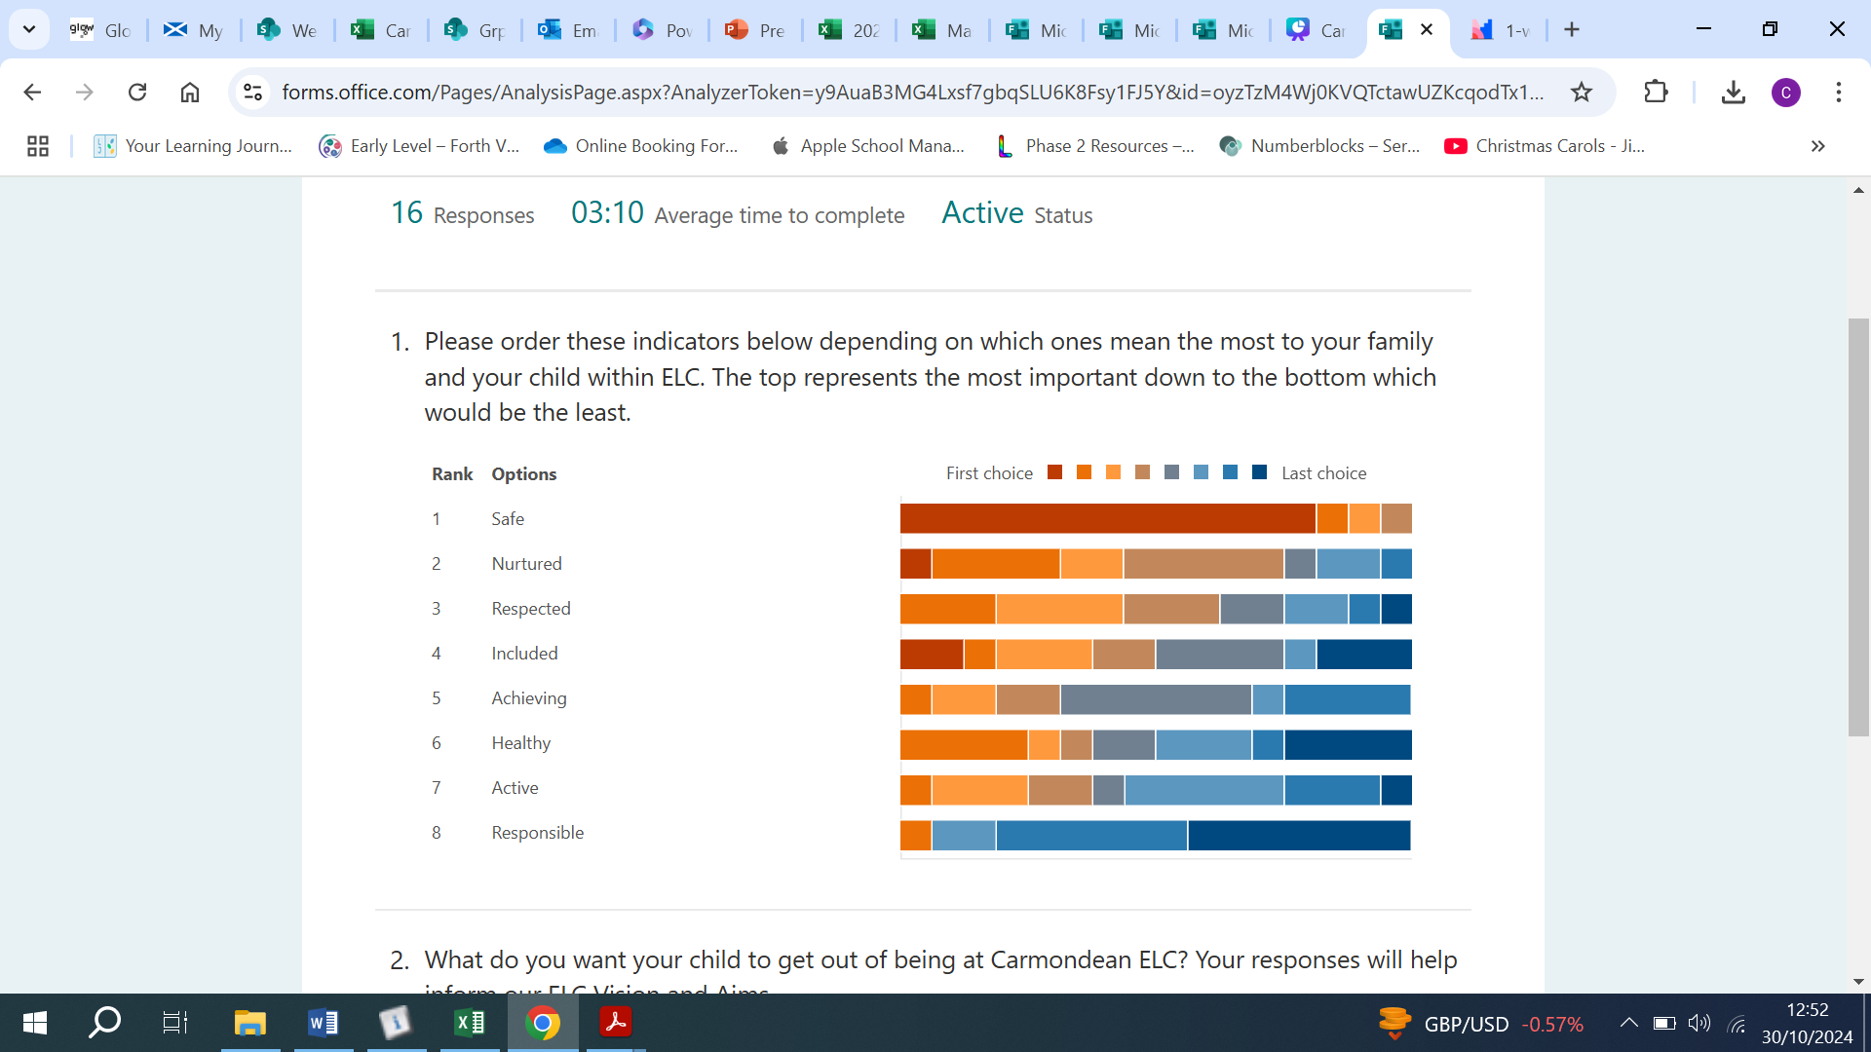
Our families were asked their views...

Slide 12
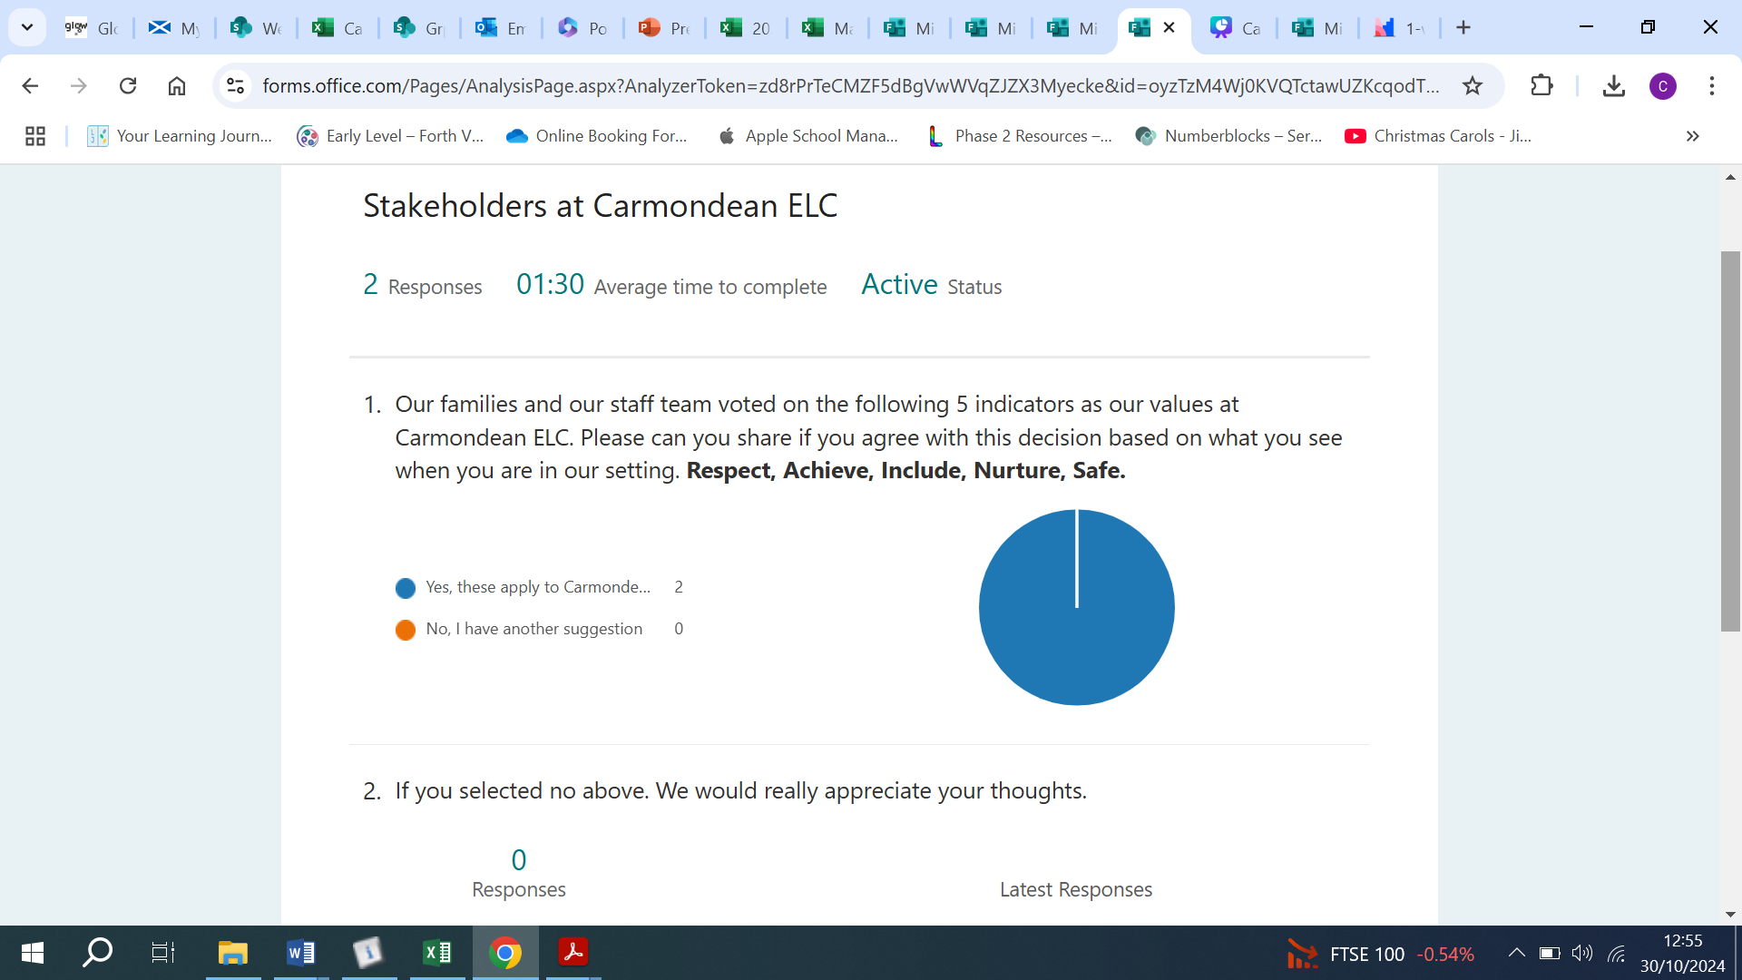
And our stakeholders agreed...

Slide 13

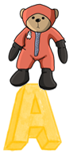



These values underpin everything we do at Carmondean and have been developed in collaboration with families, staff and stakeholders. The use of the ‘Buddies’ will help us promote understanding with our children as each value has an associated ‘Buddy’.
Safe
Achieve
Nurture
Respect
Include

Slide 14

Our Aims...
All of this information combined has supported in the development of our aims.
Caring staff who develop warm, positive and loving relationships with our children.​
A team that works together, supporting one another and ensuring children’s interests and needs are at the heart of all we do.​
Respecting the views of all our children, families and stakeholders and working together to develop strong partnerships.​
Meeting the needs of every child within our care, ensuring up to date records and regular communication with our families.​
Others’ beliefs, values and opinions are respected. We encourage all our children, families and stakeholders to share their diverse beliefs, values and opinions and use these to learn about our community and the world around us.​
Nature and our local community are valued. Children have ample opportunities to learn through nature every day with access to our stimulating garden and wooded areas.​
Develop children’s skills for learning, life and work through stimulating, first hand experiences that encourage curiosity and independence.​
Every child feels safe, valued and is supported to reach their fullest potential.​
Achievements of all are celebrated and valued. ​
Nurture the talents and interests of all our children, families and staff.​

